Slide 1

LAB-13
Study and configure Network
Address Translation(NAT).
Computer Networks (CN)
DU #2301CS501
Prof. Maulik D Trivedi
Computer Engineering
maulik.trivedi@darshan.ac.in
+91-9998265805
Disclaimer: The images used in this presentation are sourced solely for educational and nonprofit purposes. The author of this presentation asserts no ownership or copyright claims over them."

Slide 2
What is NAT?
Network Address Translation (NAT)
NAT translates IP addresses as packets cross between network boundaries.
Private IPv4 addresses are normally used inside an organization.
NAT allows these hosts to communicate with external/public networks.
Translation is performed by a NAT-enabled router/firewall.
It reduces the requirement for globally routable IPv4 addresses.

Slide 3
Main NAT Types
Static NAT creates a persistent one-to-one mapping, while PAT allows multiple inside hosts to share a public address
Types | Mapping
Static NAT | 1 private IP ↔ 1 public IP
Dynamic NAT | Private IP ↔ address from public pool
PAT | Many private IPs ↔ one/few public IPs using ports

Slide 4
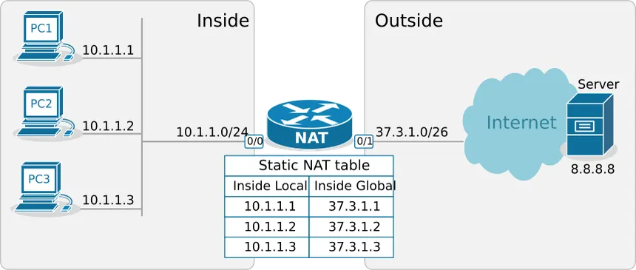
NAT Terminology

Slide 5
Static NAT
Static NAT creates a permanent one-to-one mapping between a private and public IP address.
Our Mappings:
  PC1 10.1.1.1 → 37.3.1.1
  PC2 10.1.1.2 → 37.3.1.2
  PC3 10.1.1.3 → 37.3.1.3
Characteristics
  Fixed translation
  One private IP requires one public IP
  Suitable for servers requiring a permanent public address
  Easy to predict and troubleshoot
Packet Flow:
  10.1.1.1 → NAT Router → 37.3.1.1 → 8.8.8.8

Slide 6
Static NAT Configuration
Cisco IOS Configuration
For PC1:
  Router(config)# ip nat inside source static 10.1.1.1 37.3.1.1
For PC2:
  Router(config)# ip nat inside source static 10.1.1.2 37.3.1.2
For PC3:
  Router(config)# ip nat inside source static 10.1.1.3 37.3.1.3
Configure NAT Interfaces
Router(config)# interface g0/0
Router(config-if)# ip nat inside
Router(config)# interface g0/1
Router(config-if)# ip nat outside

Slide 7
Port Address Translation
PAT / NAT Overload
PAT allows multiple private devices to share a single public IP address.
Unlike Static NAT, PAT also translates the TCP/UDP port number to distinguish different connections.
The router creates different port mappings:
  10.1.1.1:5000 → 37.3.1.62:30001
  10.1.1.2:5001 → 37.3.1.62:30002
  10.1.1.3:5002 → 37.3.1.62:30003
Advantage
  Many private hosts → One public IP
  This makes PAT much more address-efficient than Static NAT.

Slide 8
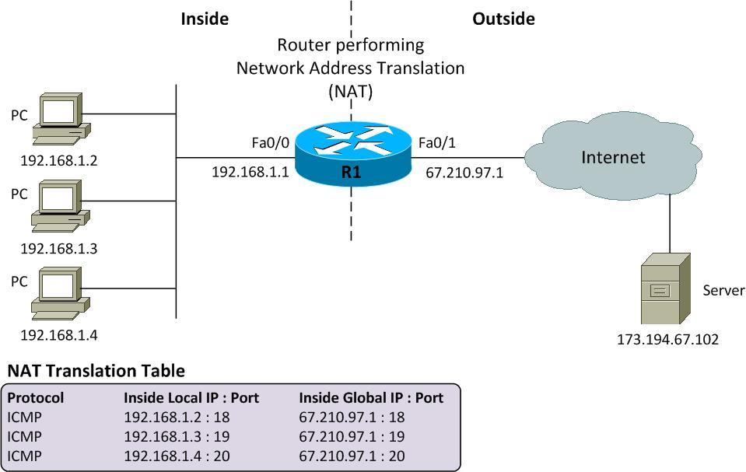
Port Address Translation Cont.

Slide 9
PAT Configuration
1. Define the inside network
  Router(config)# access-list 1 permit 10.1.1.0 0.0.0.255
2. Configure PAT
Using the router's outside interface:
  Router(config)# ip nat inside source list 1 interface g0/1 overload
3. Mark NAT interfaces
  Router(config)# interface g0/0
  Router(config-if)# ip nat inside
  Router(config)# interface g0/1
  Router(config-if)# ip nat outside

Slide 10
Verification & Testing
Verify NAT Operation
Check Translation Table
  Router# show ip nat translations
Check NAT Statistics
  Router# show ip nat statistics
Check Configuration
  Router# show running-config

Slide 11
Static NAT vs PAT
Feature | Static NAT | PAT
Mapping | 1 : 1 | Many : 1
Public IP | Dedicated | Shared
Port Translation | No | Yes
Mapping | Permanent | Dynamic
Efficiency | Lower | Higher
Typical Use | Public servers | Client Internet access
Example | 10.1.1.1 → 37.3.1.1 | 10.1.1.1:5000 → 37.3.1.62:30001
(Static NAT identifies a host by IP & PAT identifies a connection using IP + port)

Slide 12
Thank you

